Slide 1
MMAI Term Project VASH
郝瑞尼 蔡格昇 蔡宗諭

Slide 2


The Vision
“Perceptual Movie Identification”
Look at Movie content
Identify Movie (name, year, id)
100% accuracy and fully automatic

Slide 3
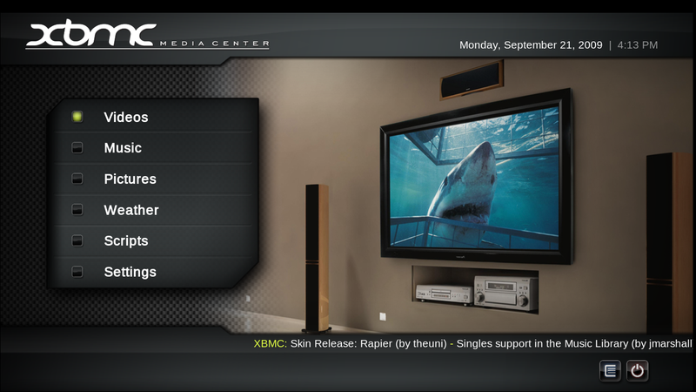
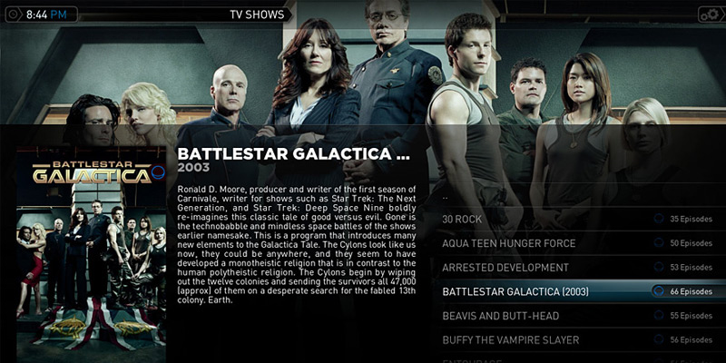
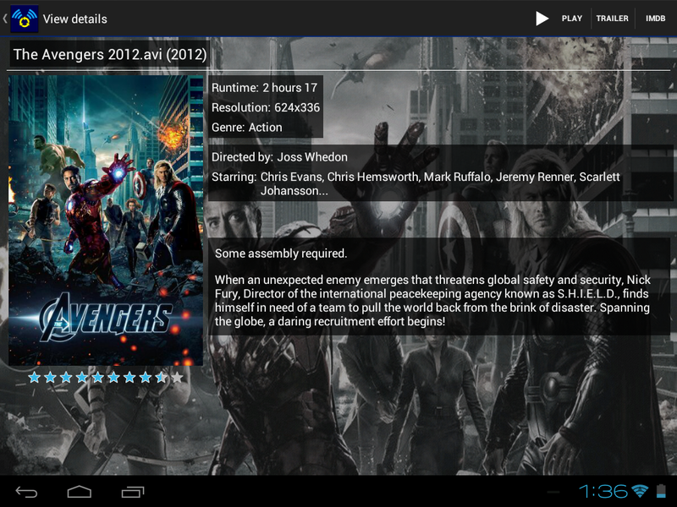
The Why?
Virtually NO metadata / tagging
HTPC software used by millions
Manually organizing media files
Wasting millions of hours
“ We can do better! “
Notes:
* HTPC software like XBMC/PLEX have very strict naming rules
* Acoustic fingerprints systems more and more popular.
Lots of companies do Acoustic fingerprints (e.g. Apple MusicMatch) Video is just a matter of time

Slide 4


I spent 2 days organizing all my movies, series and documentaries. They were already extremely organized, but not good enough for XBMC. So I created an NFO file for every episode. Was that enough? No.
Notes:
XBMC is 10 years old in 2014 and this is till an issue…

Slide 5
The How
Sample key frames from video files
Extract SIFT keypoints for video (sub-)sequences
Compute signature using Histogram of Visual Words
Match signature against our reference database
Return video identity
“ Yang et al., 2007, Evaluating bag-of-visual-words representations in scene classification ”

Slide 6
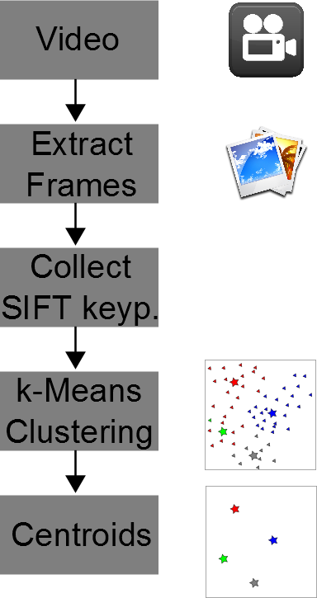
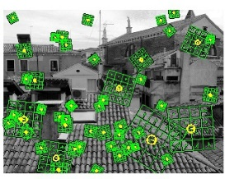
Generation of Visual Word Dictionary
Select a number of frames from videos
Compute and aggregate
SIFT keypoints
Run k-means clustering
The resulting k-centroids are the Visual Words

Slide 7
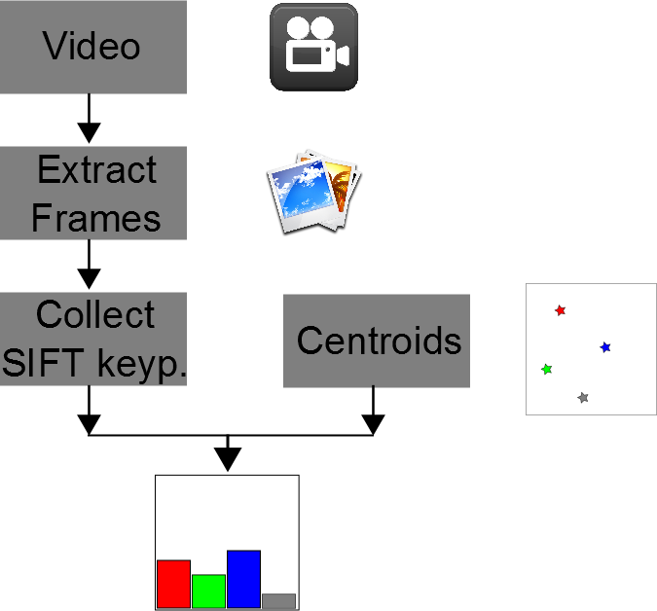
Training Signatures
Which frames to select?
Choose certain frames at certain intervals
Compute SIFT key points
Quantize keypoints to Visual Words
Compute the distances to each centroid and pick the closest one
Signature is a Histogram of Visual Words, e.g. VW 1 occurred 5 times

Slide 8
How does SIFT work?
Candidate keypoints are found by searching extrema in the Gaussian-scale space
Further refinement
Compute orientation and magnitude
Combine to keypoint descriptor
“ D. G. Lowe, 2004, Distinctive Image Features from Scale-Invariant Keypoints, Int. Journal of Computer Vision “

Slide 9
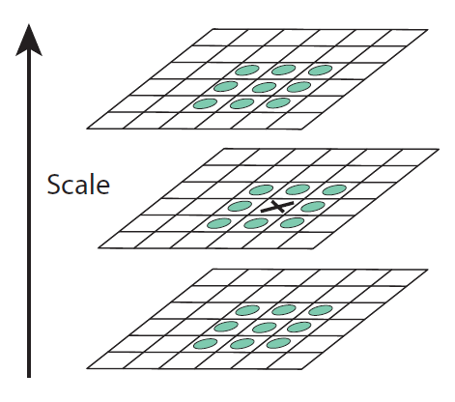
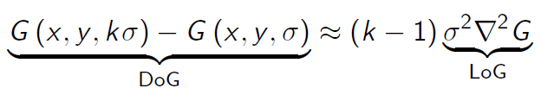
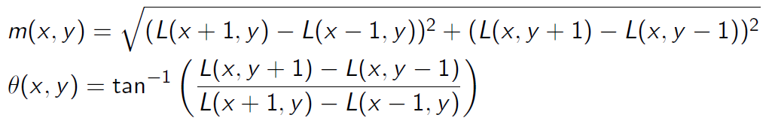
SIFT keypoint discovery
Extrema
Use a DoG approximation for faster computation
Give the current and two neighboring scales, select a point if all 26 neighbors have smaller or greater value
Orientation

Slide 10
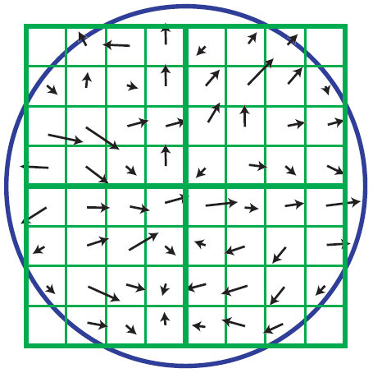
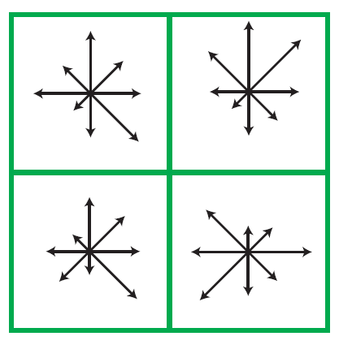
SIFT keypoint discovery
The orientations in an area around the keypoint
Binning - Creating a histogram from the orientations in the left figure
Note: In his paper, Lowe recommends 4x4x8 histograms instead of 2x2x8 ones.

Slide 11
Evaluation
DataSet 1: True Blood – Season 5 (12 episodes, real-world data)
DataSet 2: CC_WEB_VIDEO: Near-Duplicate Web Video Dataset
Evaluate with k=100 and k=1000 visual words respectively
Evaluate against 9 attack types (logo, subtitles, crop, etc)
Test each video for each attack (Null-Attack is naturally 100%)
Performance for k=1000 (on Intel Core 2 Duo 2.54 GHz)
Generate Centroids 43:30 min
Train Signatures 02:02 min
Query 9 sec

Slide 12

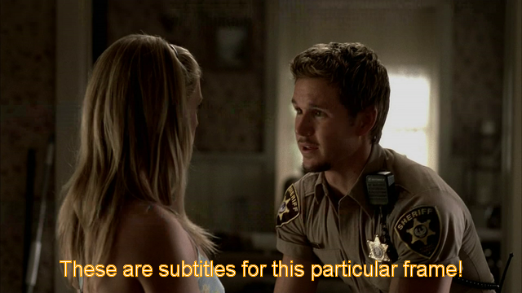

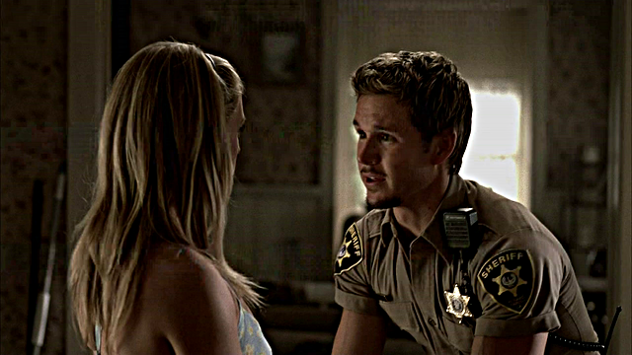

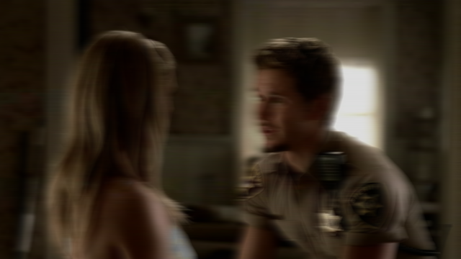
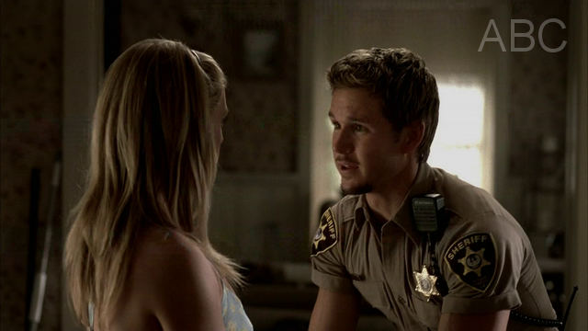
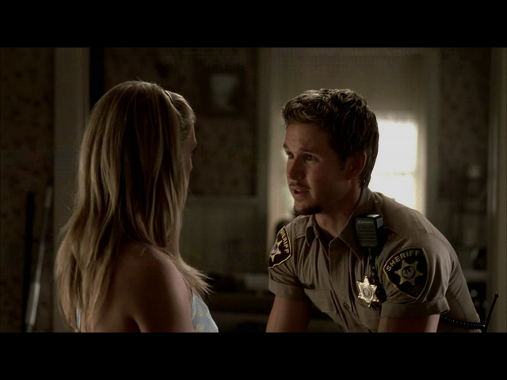

Test Results
Attack Type | Accuracy k=100 | Accuracy k=1000
Heavy Blur | 8 % | 8 %
Light Blur | 38 % | 75 %
Motion Blur | 8 % | 8 %
Radial Blur | 8 % | 8 %
Crop | 100 % | 100 %
Logo | 100 % | 100 %
Heavy Sharpen | 33 % | 92 %
Light Sharpen | 42 % | 100 %
Subtitles | 96 % | 100 %
k … size of visual word vocabulary

Slide 13
Future Works
More evaluation with real world data required
Detection of the same movie with slightly different length
Detection of the same movie in different codecs (and key frame intervals)
Bigger data sets for testing real world attacks
Distributed collection of vocabulary and signatures
Fusion of Features (e.g. SIFT features + Color Histogram)

Slide 14

THE END
謝謝
Questions?
Visit us at http://vash.in

